Slide 1

Website Creation for Assignment
KAN/IT/2021/F/110
C.KIDURSHALINI

Slide 2
Details about web site
Website create for FOOD
Website has 8 pages
Home
About
Food type
Veg
Non veg
Food items
Healthy food
Fast food
Feedback

Slide 3
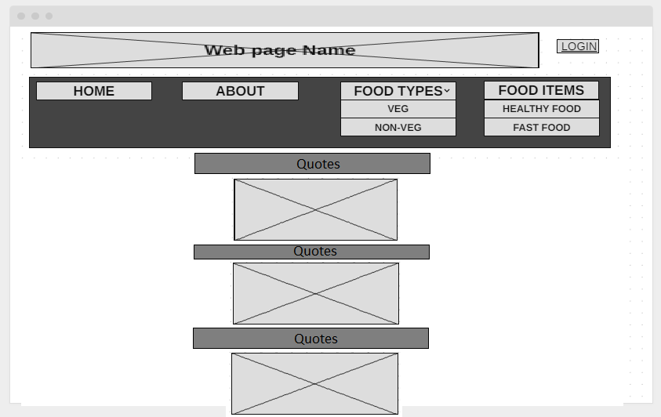
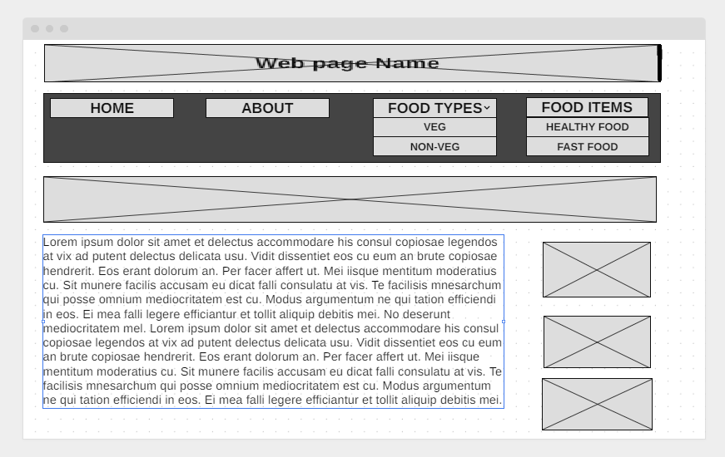
Wire frames
Home
About

Slide 4
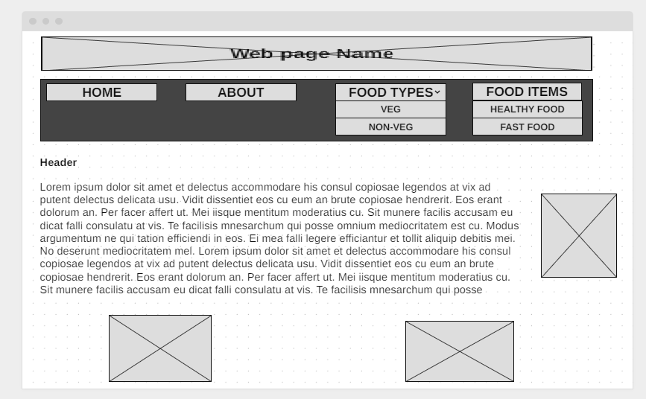
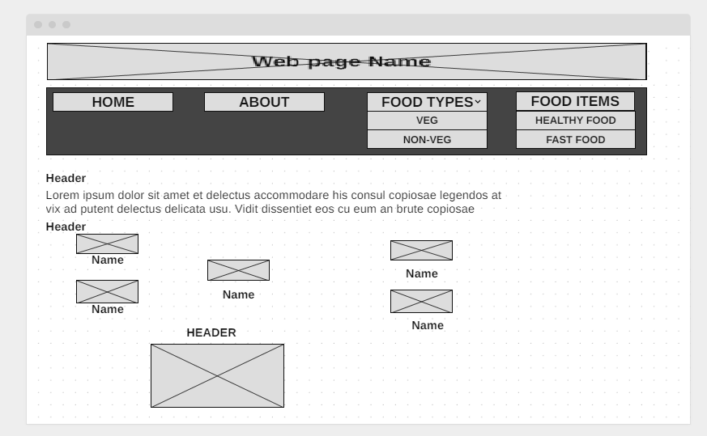
Healthy food
Fast-food

Slide 5
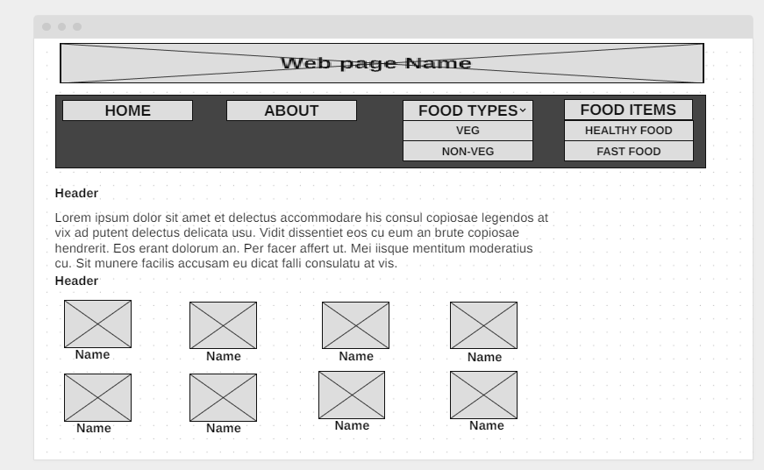
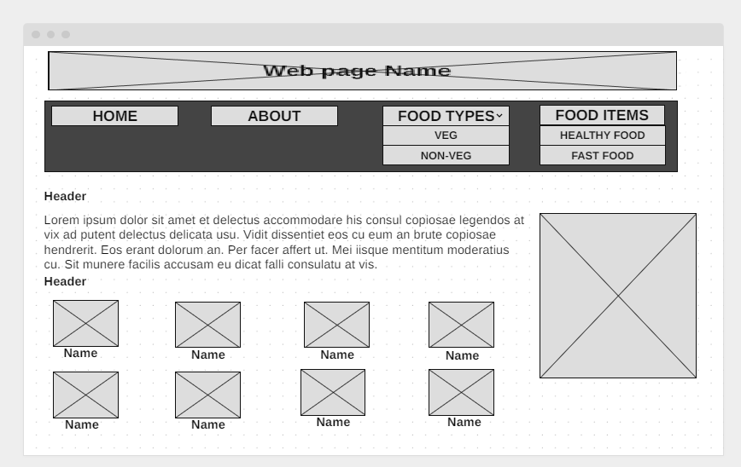
Non Veg
Veg

Slide 6
My Web site Link home page link.html

